Slide 1




MINI FADEC
ELECTRONICS ENGINEERING
EE-227
INELLIGENT MOTOR CONTROL SYSTEM
USING ARDUINO
PRESENTERS :
ALEENA KABIR
AYESHA CHAUDHRY
AYESHA YASEEN
WAJEEHA ZUBAIR

Slide 2
PROBLEM STATEMENT
EXISTING PROBLEM
NEED
MANUAL MOTOR CONTROL
NO FEEDBACK
NO SAFETY INTERLOCKS
INTELLIEGNT AUTOMATION
THERMAL PROTECTION
STABLE SPEED REGULATION

Slide 3
SYSTEM ARCHITECTURE
THROTTLE
ARDUINO
PWM
BTS 7960
MOTOR
ENCODER
ENCODER
LM35
LM35
ARM SWITCH

Slide 4
CONTROL LOGIC
NORMAL MODE
WARNING MODE
CRTITCAL MODE
GREEN LED
YELLOW LED
RPM LIMIT
RED LED
CONTROLLED SHUTDOWN

Slide 5

WHY THIS IS MORE THAN BASIC MOTOR CONTROL ???
Closed-Loop RPM feedback
Progressive Warning System
Smooth Spool-up / Spool-down
Intelligent thermal protection

Slide 6
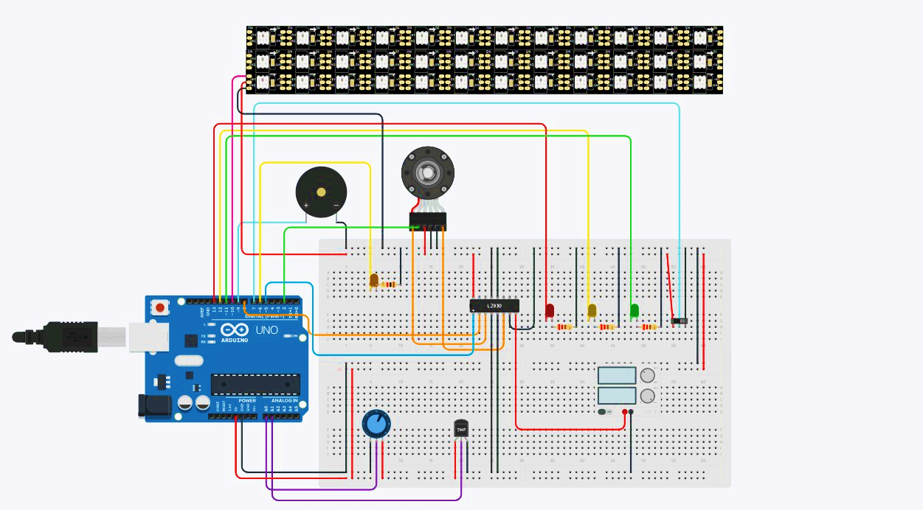
CONCLUSION
Successfully bridged embedded electronics with Aerospace Control System

Slide 7


ANY QUESTIONS ???
THANKYOU !!!

